Slide 1

Linking Desires with Destinations
CS_5363_001 – Project Team 4
Akash Machra
Anjikya Tiwari
Bhavya Batra
Manohar Kotapati
Roshan Shetty
Vinay Deshpande
Presentation Date
06 October 2015

Slide 2
Isn’t it Awesome ?
Finest combination of 7 necessities.
Because “Space” matters.
“Best of the breed” experience.
Logical navigation.

Slide 3
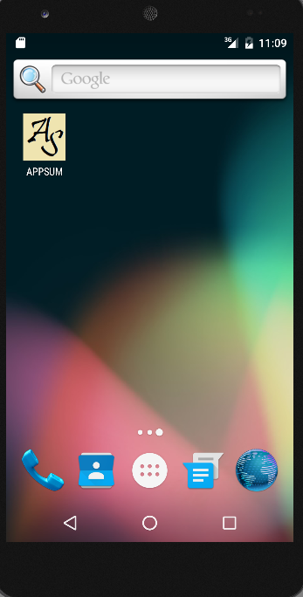
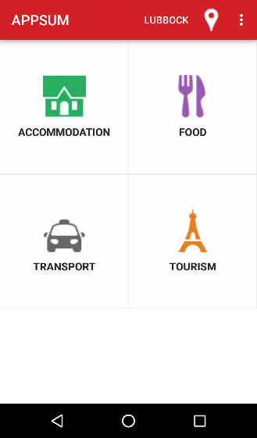
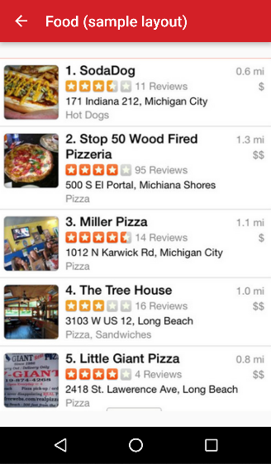
The Design

Slide 4




APIS
Name of the API | Type of the API
Zomato API | Food / Dining
Uber Cabs API | Travel
Trip Advisor API | Tourism
Hotels.com API | Accommodation

Slide 5
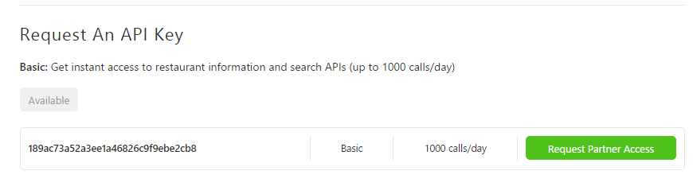
An INSTANCE
Zomato API Key

Slide 6
REQUIREMENTS
Operational and Market Feasibility
Food, Accommodation, Entertainment, Emergency, Travel, Tourism, Education
Consolidated All-Purpose Application
Technical Feasibility
S/W Resources : Android Studio, Java, Operating systems, Pre-Requisites
H/W resources
Technical Personnel
System Requirements (Iteration 2 Specific) :- Location Finder, Home Screens

Slide 7
Iteration 1
Previously, on

Slide 8
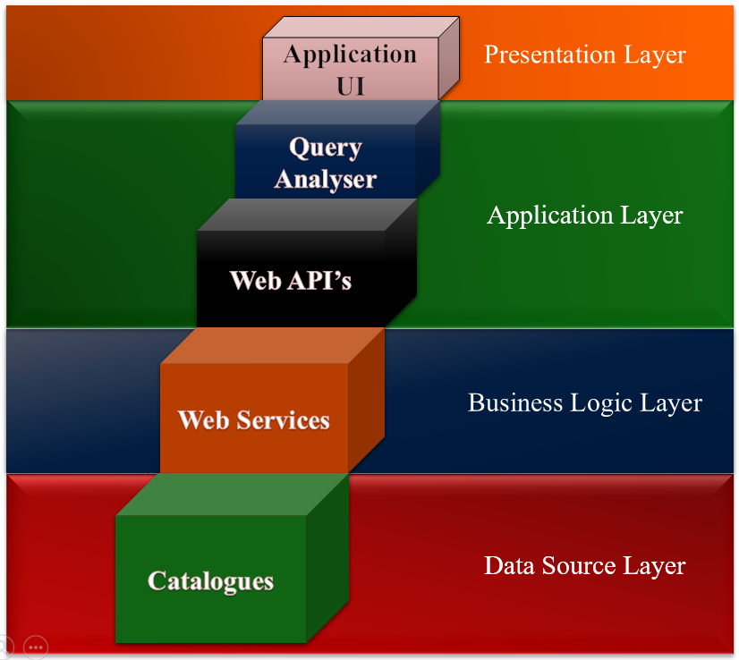
Architecture

Slide 9
Iteration 2
Architecture Decomposition
View

Slide 10
ADV
Appsum
App Screens
API’s
Web Services
Database
Communication Channel
Authentication Module
Master Screen
Location Finder
External API
Internal API
Travel
Food
Entertainment
Education
Tourism
Shelter
Emergency
Tables
Views
Stored Procedures
Encryption Algorithm
Security Certificates
Navigation Screens
Tiles
Integration Modules
Query Listener
Query Analyser
Query Responder
Hooks
MS-QL Hook
QL-QA Hook
QA-QR Hook
QR-API Hook
API-NS Hook

Slide 11
Iteration 2
Work Breakdown Structure

Slide 12
WBS-I
Appsum
1. Feasibility Study
2.1 Architecture
2.2 Work Break Down Structure
2.3 Estimation
2.4 Financial Feasibility/ Costing
3. Appsum Development
3.1 App Screen
3.2 API’s
3.3 Databases
3.4 Web Services
3.5 Query Engine
3.6 Communication Channel
3.7 Authentication Module
4. Regression Testing
4.1 System Testing
4.2 Performance Testing
5. Maintenance
6. Delivery
1.1 Market Feasibility
2. Project Management
1.2 Operational Feasibility
1.3 Technical Feasibility

Slide 13
WBS-II
3. Appsum
Development
3.1 App Screens
3.2 API’s
3.4 Web Services
3.3 Database
3.6 Communication Channel
3.7 Authentication Module
3.1.1 Build Master Screen
3.1.1.1 Design Location Finder
3.2.1 External API
3.2.2 Internal API
3.2.1.1 Travel, Food, Shelter, Education, Tourism, Entertainment
3.2.2.1 Emergency
3.3.1 Create Tables
3.3.2 Create Views
3.3.3 Create Stored Procedures
3.1.2 Navigation Screens
3.1.1.2 Design Tiles
3.5 Query Engine
3.5.1 Query Listener/ Analyser/ Responder
3.5.2 Integration Hooks
3.5.2.1 MS-QL-QA-QR-API Hooks
3.5.2.1.1 Implement
3.5.2.1.2 Integrate
3.5.2.1.3 Test
3.1.1.3 Implement LF
3.1.1.4 Implement Tiles
3.1.1.5 Unit Testing
3.1.1.6 UAT
3.1.2.1 Design
3.1.2.2 Implement
3.1.2.3 Unit and UAT
3.2.1.1.1 Spike Test
3.2.1.1.2 Implement
3.2.1.1.3 Integrate
3.2.1.1.4 Unit and UAT
3.2.2.1.1Design
3.2.2.1.2 Implement
3.2.2.1.3 Integrate
3.2.2.1.4 Unit and UAT
3.5.1.1 Design
3.5.1.2 Implement
3.5.1.3 Integrate
3.5.1.4 Unit test
3.5.1.5 UAT
3.6.1.1 Spike Test
3.6.1.2 Design
3.6.1.3 Implement
3.6.1.4 Unit Test
3.6.1 Security Certificates and Encryption Algorithm
3.4.1 Design
3.4.2 Implement
3.4.3 Unit and UAT
3.7.1 Design
3.7.2 Implement
3.7.3 UAT

Slide 14
Risks - Beware
Insecure Development Practices.
Security Breaches and Attacks.
Hardware Crash.
Software Crash.
API Risks.
Malicious Code Injection
Business Logic Attacks
Identity and Session Threat
Service Information Leakage

Slide 15
Dealing with Risks
Identify Vulnerabilities an API already has.
Monitor, Audit, Log and Analyze API Traffic.
Encrypt the Message Channels.

Slide 16
Schedule – Iteration 2
Duration - 3 weeks
Training
Investigation on external APIs
Prototype

Slide 17
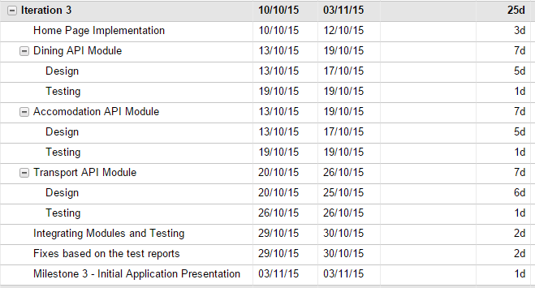
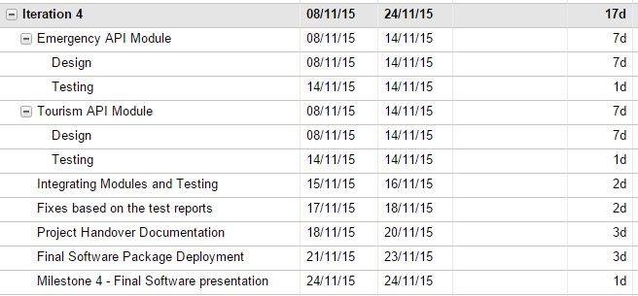
And ROSTER

Slide 18
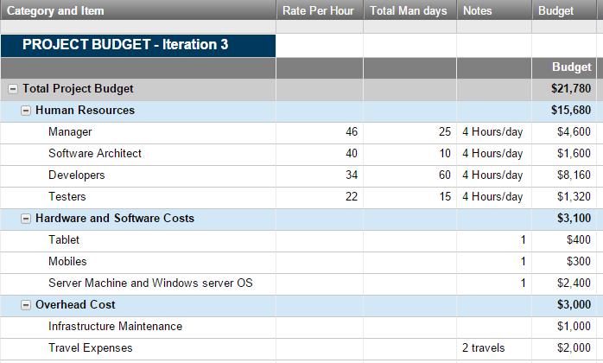
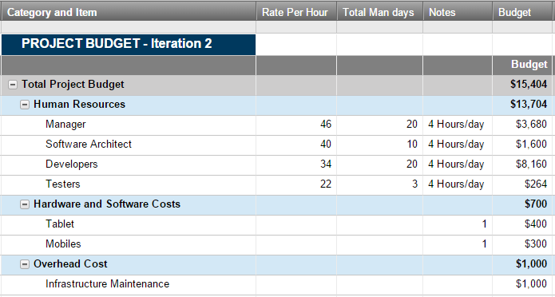
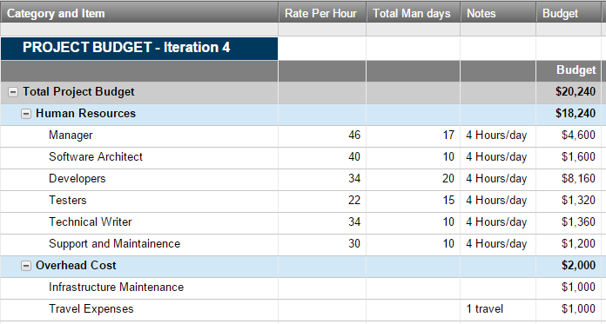
BECAUSE $ STILL MATTERS

Slide 19
WORKOUT
Team Members | Android Training | Java Training | Screens | ADV | WBS | Budget | Requirements | API | Risk Mgmt | Schedule
Anjikya Tiwari | ü | ü | ü
Akash Machra | ü | ü |  |  |  | ü | ü
Bhavya Batra | ü | ü |  | ü | ü
Manohar | ü | ü | ü |  |  | ü |  |  |  | ü
Roshan | ü | ü | ü |  |  |  |  |  | ü
Vinay | ü | ü |  |  |  |  |  | ü

Slide 20
Software Demo – Iteration 2
Things we did…
Launcher Icon
Designed home page layout with menu items
Space on Action bar for current city indication and location icon to change the city
Functionality of auto detecting current city and changing city not yet implemented. To show the expected layout, current city is hardcoded as Lubbock
Select the Food menu item for expected sample layout that we are going to design in coming iteration
Test cases for this iteration
Application launch with APPSUM icon
Home page with 4 menu items
Title display on selection of each menu item
Sample layout image on selecting Food menu item
Check field on action bar for current city (Auto detecting not yet implemented)
Location icon to change the city ( Functionality not yet implemented)

